Slide 1
Final Project CIS-25 C++
Joshua Annonson

Slide 2
Desert Island Survival Game
A text-based video game of survival on a tropical island
Move about a small island to investigate each area and find food
^{Last 30 days without starving}
Movement or actions take up time and hunger
Random Island generation for replayability
^{Save and Load system}

Slide 3
Program Structure
Area – virtual base class for the island
Biomes – brake down of different areas, descriptions, actions
Player – handles hunger, days survived, and movement
Save System – handles save/load of the island config and player progress
Game – handles generating a random island, the main game loop of taking player actions, and gameover message
Main – prompts new game or load, runs game, deletes memory usage at gameover

Slide 4
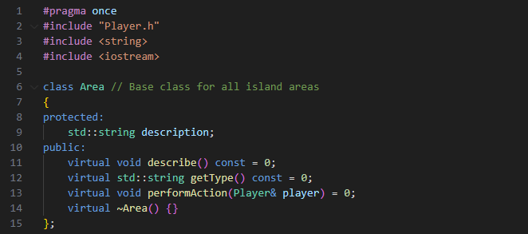
Area

Slide 5
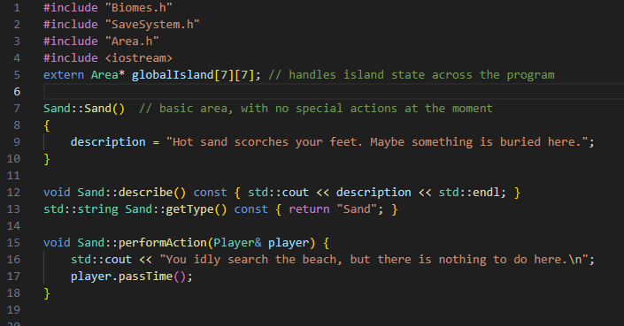
Biomes

Slide 6
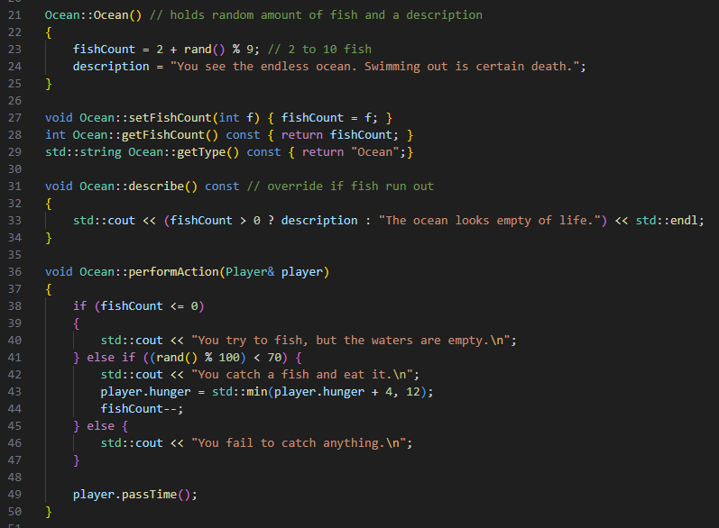

Slide 7
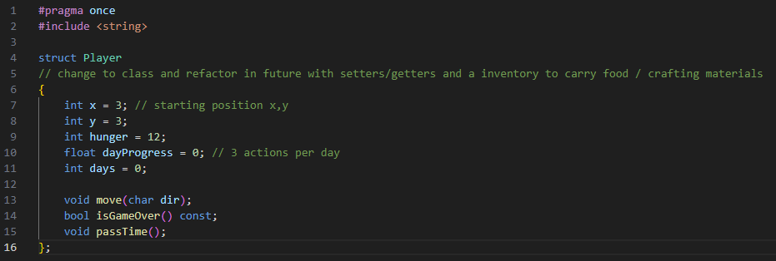
Player

Slide 8
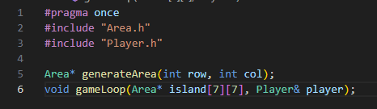
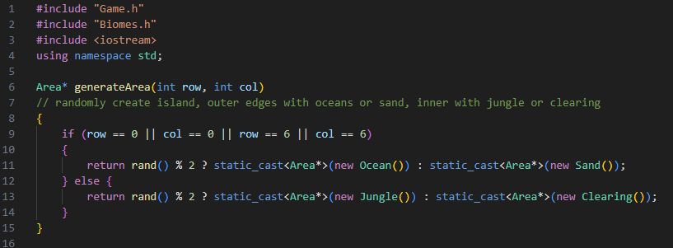
Game

Slide 9
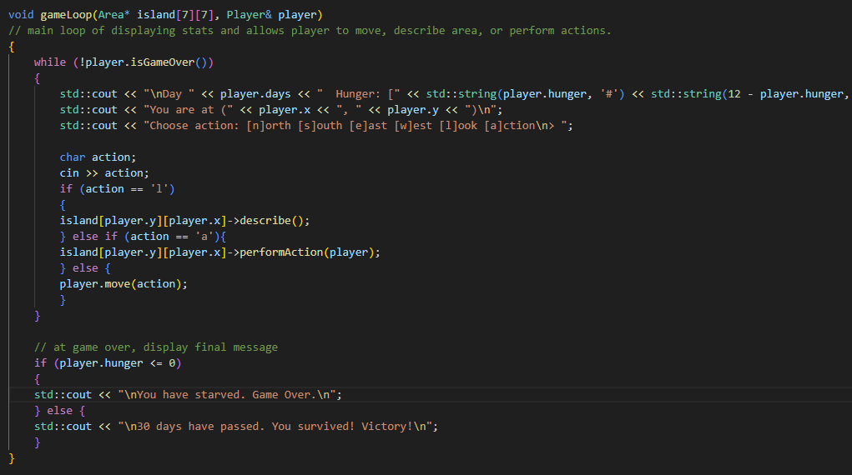

Slide 10
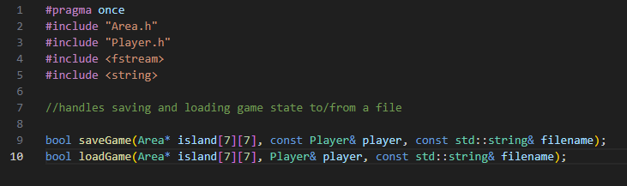
Save / Load

Slide 11
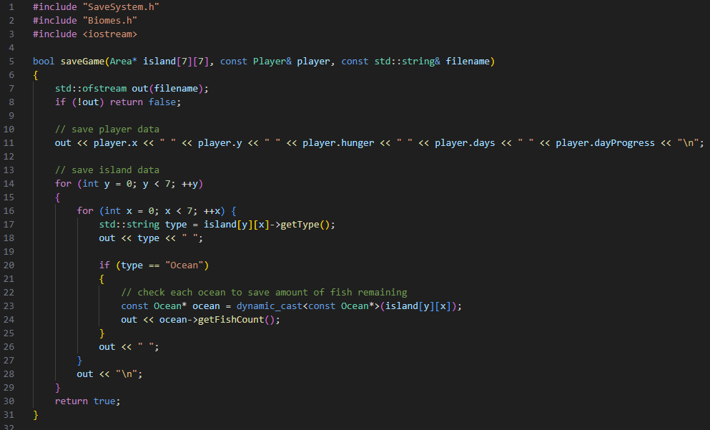

Slide 12
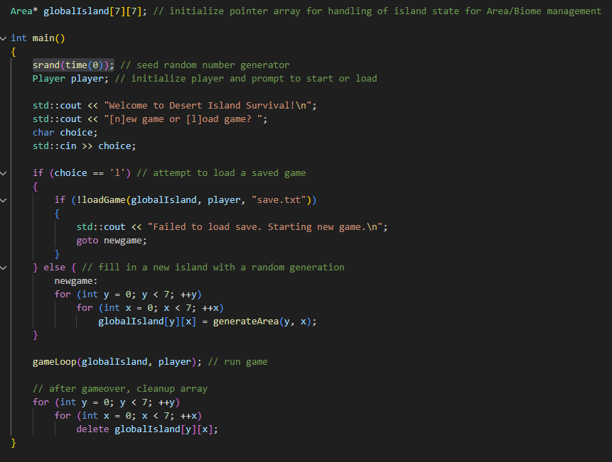
Main

Slide 13
